Slide 1



Corona Virus Analysis

Slide 2
Project Overview
The "Corona Virus Analysis" project aims to provide data-driven insights into the COVID-19 pandemic using SQL. By analyzing a comprehensive dataset, we seek to understand the spread and impact of the virus across different regions and over time. This analysis will help identify patterns and trends that can inform public health strategies and responses.

Slide 3
Importance of Analysis
Effective Response: Tracking virus spread, allocating resources, and predicting healthcare needs.
Informed Decisions: Guiding policy on lockdowns, social distancing, and vaccine distribution.
Economic Stability: Assessing impacts and planning targeted relief measures.
Future Readiness: Strengthening preparedness for future health crises through insights and adjustments.’
This analysis is fundamental for proactive and effective public health and policy responses amidst the pandemic and for building resilience against future challenges.

Slide 4
Dataset Description
Columns Description:
Province: Geographic subdivision within a country/region.
Country/Region: Geographic entity where data is recorded.
Latitude: North-south position on Earth's surface.
Longitude: East-west position on Earth's surface.
Date: Recorded date of COVID-19 data.
Confirmed: Number of diagnosed COVID-19 cases.
Deaths: Number of COVID-19 related deaths.
Recovered: Number of recovered COVID-19 cases.

Slide 5
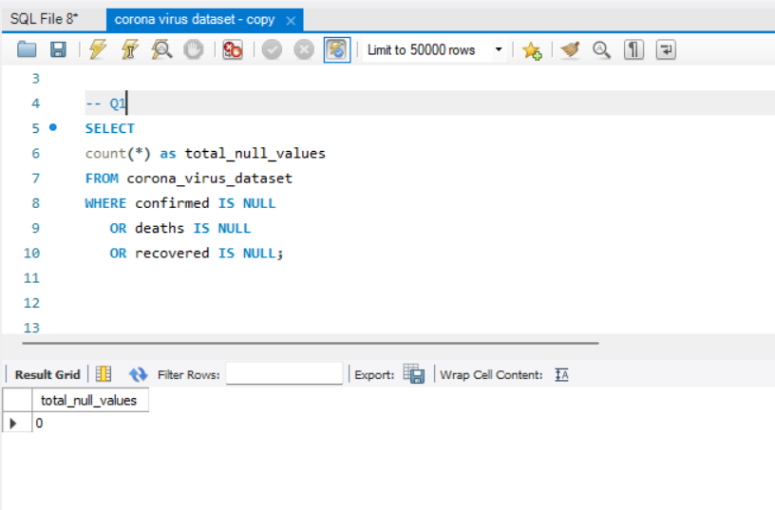
Q1. Write a code to check NULL values

Slide 6
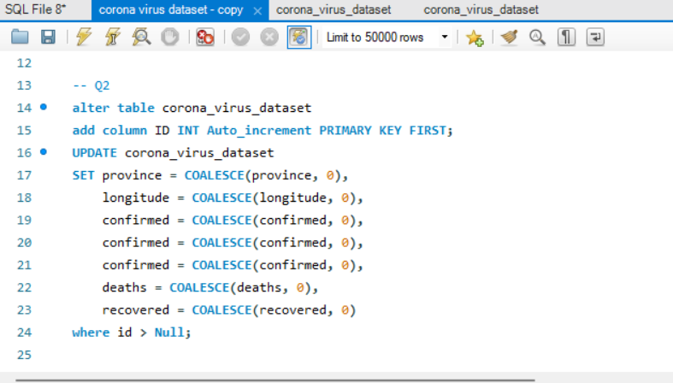
Q2. If NULL values are present, update them with zeros for all columns.

Slide 7
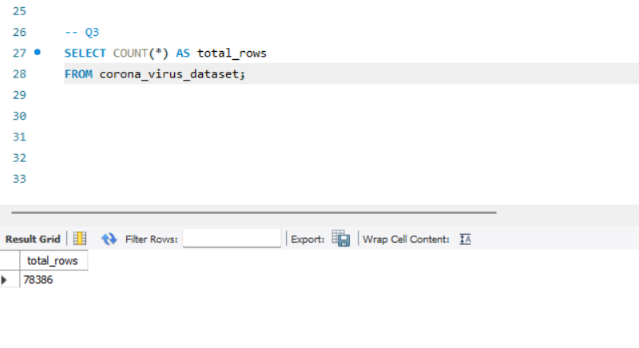
Q3. check total number of rows

Slide 8
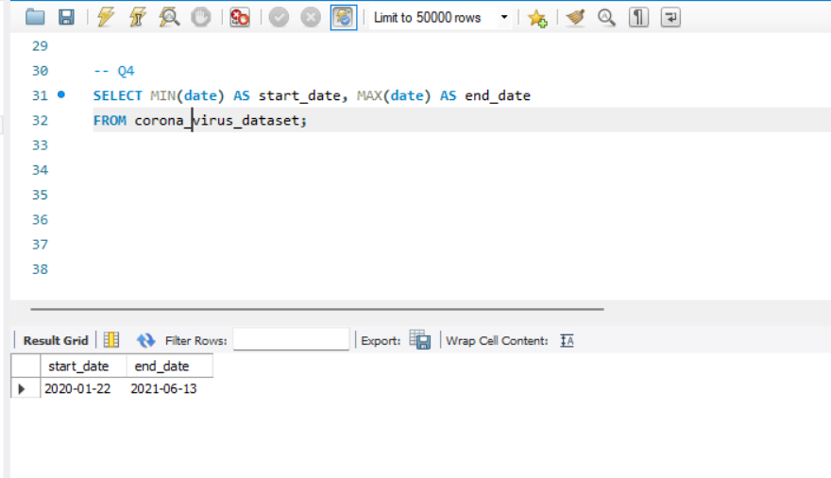
Q4. Check what is start_date and end_date

Slide 9
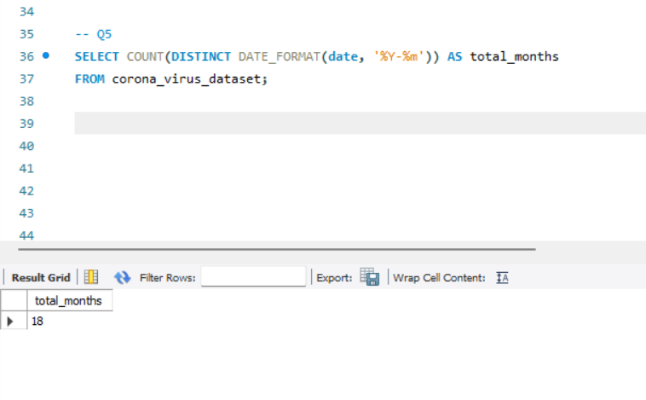
Q5. Number of month present in dataset

Slide 10
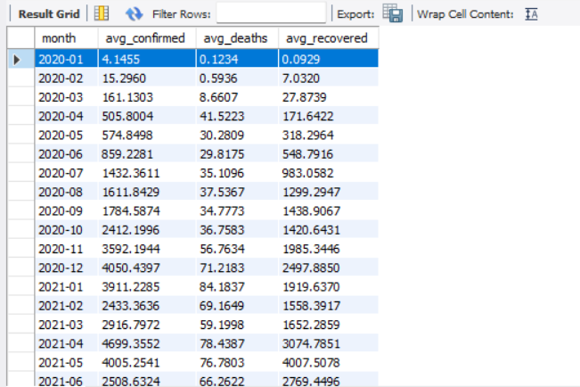
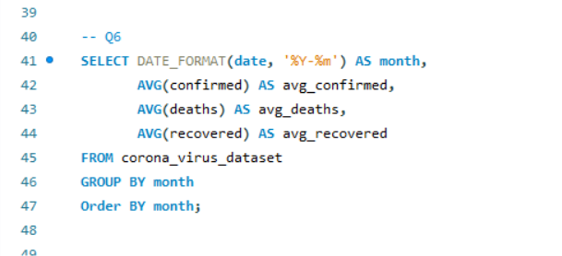
Q6. Find monthly average for confirmed, deaths, recovered

Slide 11
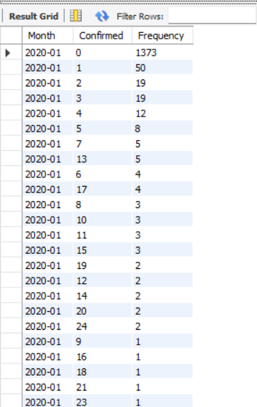
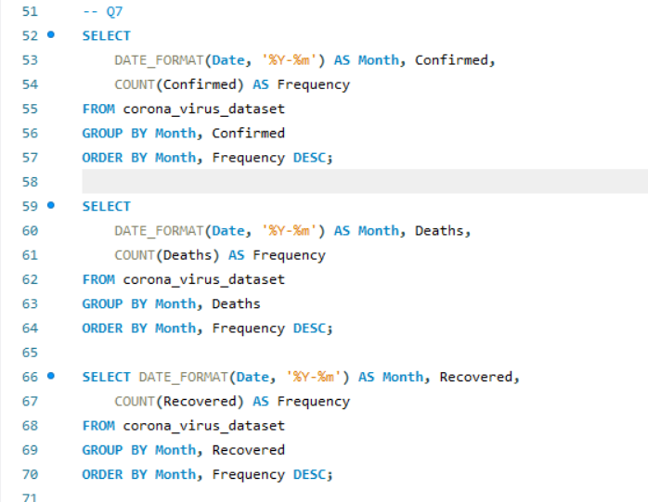
Q7 Find most frequent value for confirmed, deaths, recovered each month

Slide 12
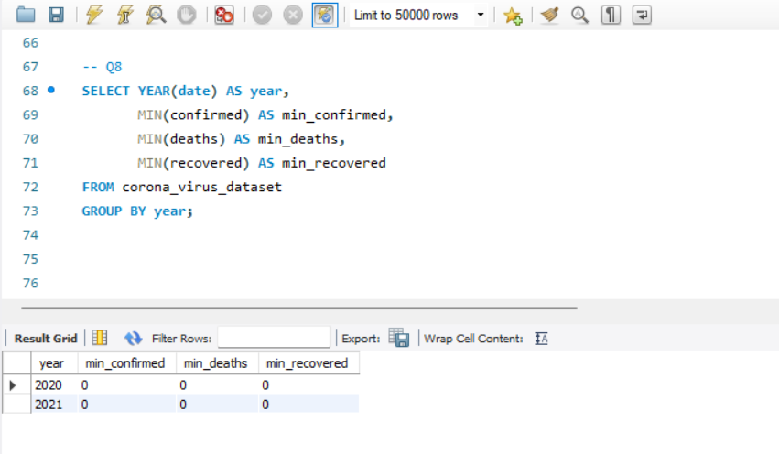
Q8. Find minimum values for confirmed, deaths, recovered per year

Slide 13
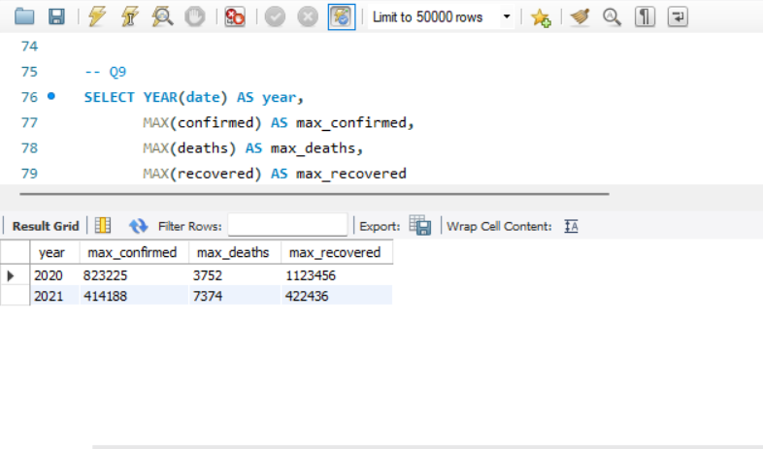
Q9. Find maximum values of confirmed, deaths, recovered per year

Slide 14
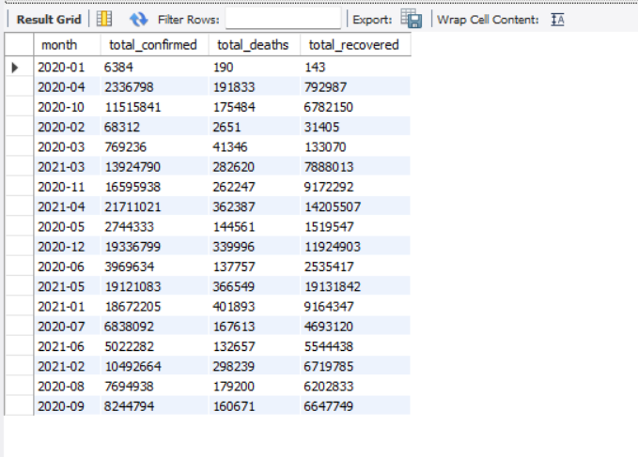
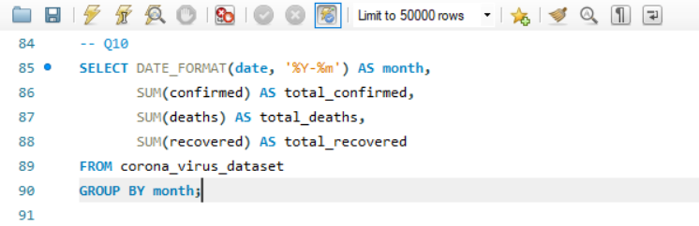
Q10. The total number of case of confirmed, deaths, recovered each month

Slide 15
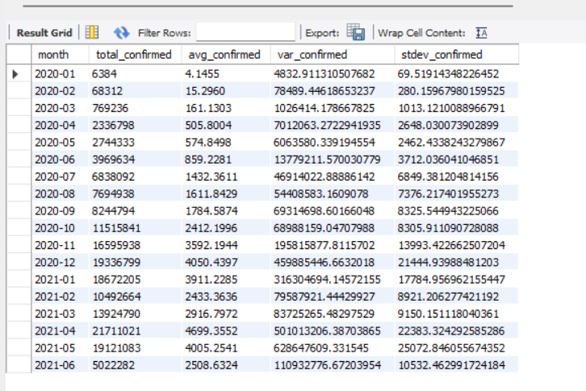
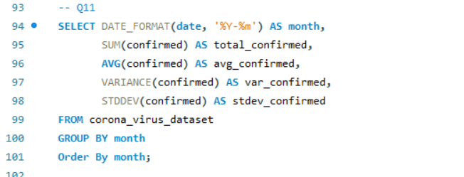
Q11. Check how corona virus spread out with respect to confirmed case

Slide 16
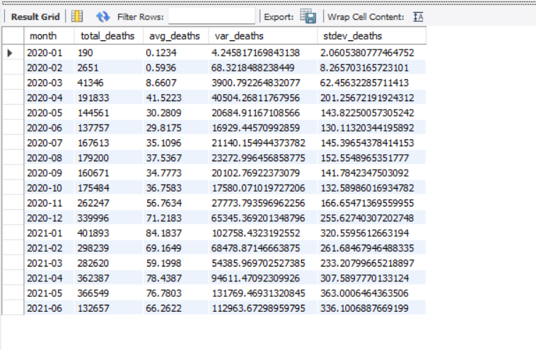
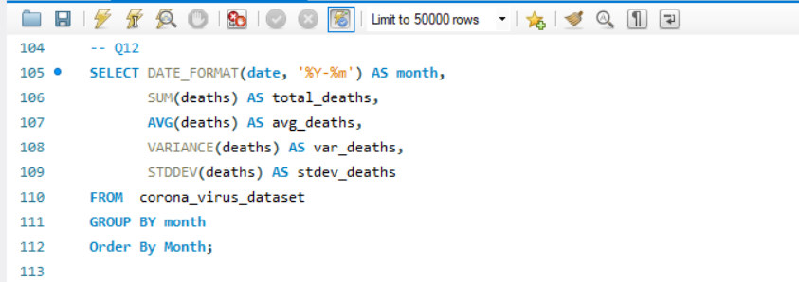
Q12. Check how corona virus spread out with respect to death case per month

Slide 17
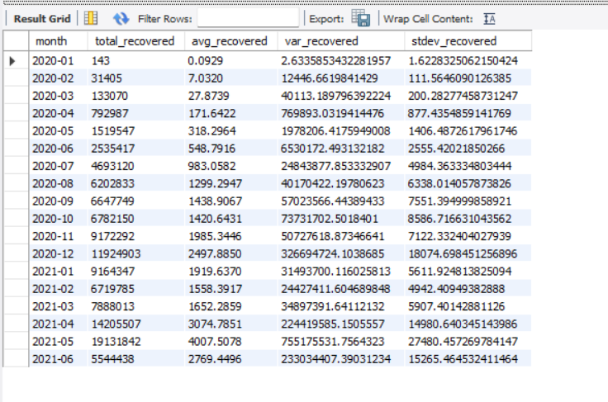
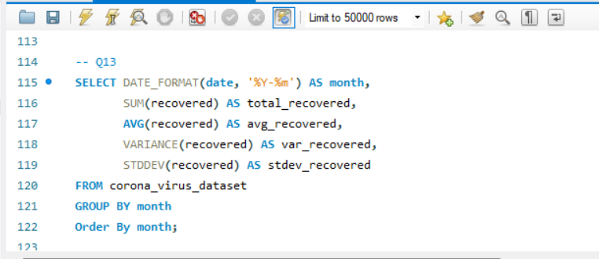
Q13. Check how corona virus spread out with respect to recovered case

Slide 18
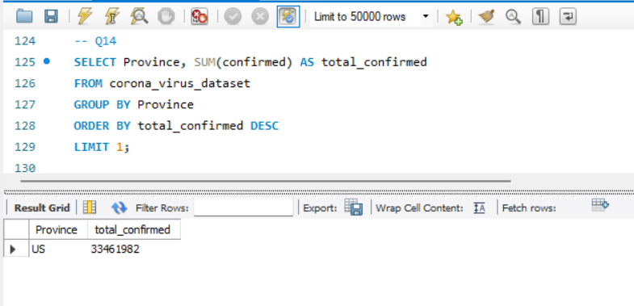
Q14. Find Country having highest number of the Confirmed case

Slide 19
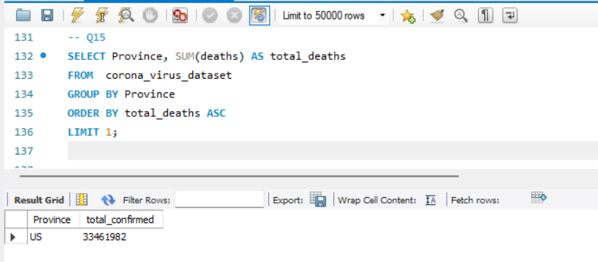
Q15. Find Country having lowest number of the death case

Slide 20
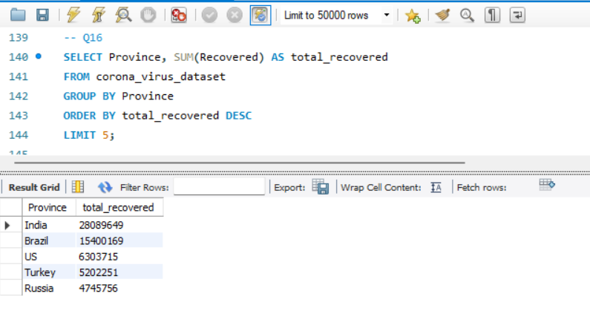
Q16. Find top 5 countries having highest recovered case

Slide 21
Conclusion
"In conclusion, the analysis of COVID-19 data is essential for understanding the spread and impact of the virus. By tracking confirmed cases, deaths, and recoveries, we can make informed decisions to guide public health strategies and responses. This project not only helps in immediate crisis management but also prepares us for future health challenges by identifying strengths and weaknesses in our response strategies.

Slide 22

MENTORNESS!!!!!

